Slide 1
Interior Gateway Routing Protocol
IGRP is a distance vector protocol.
Reference: https://www.cisco.com/c/en/us/support/docs/ip/interior-gateway-routing-protocol-igrp/26825-5.html#intro

Slide 2
Goals for IGRP
The IGRP protocol allows a number of gateways to coordinate their routing. Its goals are the following:
Stable routing even in very large or complex networks. No routing loops should occur, even as transients.
Fast response to changes in network topology.
Low overhead. That is, IGRP itself should not use more bandwidth than what is actually needed for its task.
Splitting traffic among several parallel routes when they are of roughly equal desirability.
Taking into account error rates and level of traffic on different paths.
The current implementation of IGRP handles routing for TCP/IP. However, the basic design is intended to be able to handle a variety of protocols.
No one tool is going to solve all routing problems

Slide 3
IGP and EGP
IGP | EGP
Protocols such as IGRP are called "internal gateway protocols" (IGPs). | Such sets of (IGRP) of networks are connected by "external gateway protocols" (EGPs).
They are intended for use within a single set of networks, either under a single management or closely coordinated managements | An EGP is intended to protect one system of networks against errors or intentional misrepresentation by other systems
An IGP is designed to keep track of a good deal of detail about network topology. | Often it is sufficient for an EGP to produce a reasonable route, rather than the optimal route.
Priority in designing an IGP is placed on producing optimal routes and responding quickly to changes | Priority in designing an EGP is on stability and administrative controls.

Slide 4
IGRP Routing Problem
IGRP is intended for use in gateways connecting several networks.. A host that is connected to one network wants to send a packet to another host system on a different network, it addresses the packet to a gateway. If the destination is on one of the networks connected to the gateway, the gateway will forward the packet to the destination.
Gateways use routing tables to help them decide what to do with packets. Here is a simple example routing table.
(The basic routing problem is similar for other protocols as well, but this description will assume that IGRP is being used for routing IP.)

Slide 5
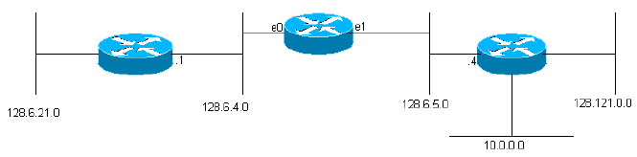
IGRP Routing
This gateway is connected to two Ethernets, called 0 and 1. They have been given IP network numbers (actually subnet numbers) 128.6.4 and 128.6.5. Thus packets addressed for these specific networks can be sent directly to the destination, simply by using the appropriate Ethernet interface.
There are two nearby gateways, 128.6.4.1 and 128.6.5.4. Packets for networks other than 128.6.4 and 128.6.5 will be forwarded to one or the other of those gateways. The routing table indicates which gateway should be used for which network.
For example, packets addressed to a host on network 10 should be forwarded to gateway 128.6.5.4. One hopes that this gateway is closer to network 10. The primary purpose of IGRP is allow the gateways to build and maintain routing tables like this.
Gateway Routing Table
network gateway interface
---- ------- ---------
128.6.4 none ethernet 0
128.6.5 none ethernet 1
128.6.21 128.6.4.1 ethernet 0
128.121 128.6.5.4 ethernet 1
10 128.6.5.4 ethernet 1

Slide 6
IGRP
IGRP is a protocol that allows gateways to build up their routing table by exchanging information with other gateways.
A gateway starts out with entries for all of the networks that are directly connected to it. It gets information about other networks by exchanging routing updates with adjacent gateways.
In the simplest case, the gateway will find one path that represents the best way to get to each network.
A path is characterized as:
Metric information is a set of numbers that characterize how good the path is. This allows the gateway to compare paths that it has heard from various gateways and decide which one to use. There are often cases where it makes sense to split traffic between two or more paths. IGRP will do this whenever two or more paths are equally good. The user can also configure it to split traffic when paths are almost equally good. In this case more traffic will be sent along the path with the better metric. The intent is that traffic can be split between a 9600 bps line and a 19200 BPS line, and the 19200 line will get roughly twice as much traffic as the 9600 BPS line.
The metrics used by IGRP include the following:
  Topological delay time : Topological delay time is the amount of time it would take to get to the destination along that path, assuming an unloaded network
  Bandwidth of the narrowest bandwidth segment of the path: The path bandwidth is simply the bandwidth in bits per second of the slowest link in the path
  Channel occupancy of the path: Channel occupancy indicates how much of that bandwidth is currently in use. It is measured, and will change with load.
  Reliability of the path: Reliability indicates the current error rate. It is the fraction of packets that arrive at the destination undamaged. It is measured.
host | next gateway to which packets should be sent | the network interface that should be used | the metric information

Slide 7
IGRP cont…
In IGRP, the general Bellman-Ford algorithm is modified in three critical aspects. First, instead of a simple metric, a vector of metrics is used to characterize paths. Second, instead of picking a single path with the smallest metric, traffic is split among several paths, whose metrics fall into a specified range. Third, several features are introduced to provide stability in situations where the topology is changing.
The best path is selected based on a composite metric:
  [(K1 / Be) + (K2 * Dc)] r
  Where K1, K2 = constants, Be = unloaded path bandwidth x (1 - channel occupancy)
  Dc = topological delay
  and r = reliability.
  NOTE
The path having the smallest composite metric will be the best path. Where there are multiple paths to the same destination, the gateway can route the packets over more than one path. This is done in accordance with the composite metric for each data path.
For instance, if one path has a composite metric of 1 and another path has a composite metric of 3, three times as many packets will be sent over the data path having the composite metric of 1.

Slide 8
Advantage of metric information
Two advantages to using a vector of metric information.
It provides the ability to support multiple types of service from the same set of data.
The second advantage is improved accuracy.

Slide 9
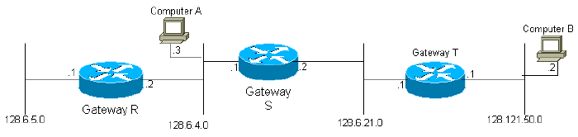
IGRP Overall Description
When a gateway is first turned on, its routing table is initialized. This may be done by an operator from a console terminal, or by reading information from configuration files. A description of each network connected to the gateway is provided, including the topological delay along the link (for example, how long it takes a single bit to transverse the link) and the bandwidth of the link.
There are four networks 1,2,3,4. For instance, initially, gateway S would be told that it is connected to networks 2 and 3 via the corresponding interfaces. The gateways transmit their table to neighbour gateways. Thus, gateway S would receive updates from gateways R and T and learn that it can reach computers in network 1 through gateway R and computers in network 4 through gateway T. Since gateway S sends its entire routing table, in the next cycle gateway T will learn that it can get to network 1 through gateway S. It is easy to see that information about every network in the system will eventually reach every gateway in the system, providing only that the network is fully connected.

Slide 10
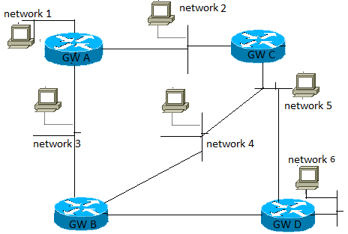
IGRP
Each gateway computes a composite metric to determine the desirability of the data paths to destination computers.
For instance, in the diagram above, for a destination in Network 6, gateway A (gw A) would compute metric functions for two paths, via gateways B and C. Note that paths are defined simply by the next hop. There are actually three possible routes from A to Network 6:
  Direct to B
  To C and then to B
  To C and then to D
However, gateway A need not choose between the two routes involving C. The routing table in A has a single entry representing the path to C. Its metric represents the best way of getting from C to the final destination. If A sends a packet to C, it is up to C to decide whether to use B or D.
Equation 1
The composite metric function computed for each data path is as shown below:
[(K1 / Be) + (K2 * Dc)] rWhere r = fractional reliability (% of transmissions that are successfully received at the next hop), Dc = composite delay, Be = effective bandwidth: unloaded bandwidth x (1 - channel occupancy), and K1 and K2 = constants.
Equation 2
In principle the composite delay, Dc, could be determined as shown below:
Dc = Ds + Dcir + DtWhere Ds = switching delay, Dcir = circuit delay (propagation delay of 1 bit), and DT = transmission delay (no-load delay for a 1500 bit message).
However, in practice a standard delay figure is used for each type of network technology. For instance, there will be a standard delay figure for Ethernet, and for serial lines at any particular bit rate.

Slide 11
Network | Interface | Next Gateway | Metric
1 | NW 1 | None | Directly connected
2 | NW 2 | None | Directly connected
3 | NW 3 | None | Directly connected
4 | NW 2 | C | 1270
 | NW 3 | B | 1180
5 | NW 2 | C | 1270
 | NW 3 | B | 2130
6 | NW 2 | C | 2040
 | NW 3 | B | 1180
Routing Table Example:
The basic process of building up a routing table by exchanging information with neighbors is described by the Bellman-Ford algorithm. In order to deal with more complex networks, IGRP adds three features to the basic Bellman-Ford algorithm:
Instead of a simple metric, a vector of metrics is used to characterize paths. It also allows a more accurate representation of the characteristics of the network than a single metric.
Instead of picking a single path with the smallest metric, traffic is split among several paths with metrics falling into a specified range. This allows several routes to be used in parallel, providing a greater effective bandwidth than any single route. Traffic is distributed among multiple paths in inverse proportion to the composite metrics.
There are some problems with this concept of variance. The effect of this is to set the variance permanently to 1.
Several features are introduced to provide stability in situations where the topology is changing. These features are intended to prevent routing loops and "counting to infinity," which have characterized previous attempts to use Ford-type algorithms for this type of application. The primary stability features are "holddowns", "triggered updates", "split horizon," and "poisoning". These will be discussed in more detail below.

Slide 12
RIP vs IGRP
SR.NO | RIP | IGRP
1 | RIP stands for Routing Information Protocol. | IGRP Stands For Interior Gateway Routing protocol.
2 | RIP works on Bellman Ford algorithm. | IGRP also works on Bellman ford Algorithm.
3 | It is a industry standard dynamic routing protocol. | It is a Cisco standard routing protocol.
4 | It is basically use for smaller size organization. | It is basically use for medium to larger size organization in the network.
5 | RIP is a distance vector protocol. | IGRP is also a distance vector protocol.
6 | It allow maximum hop count upto 15. | It allow maximum hop count upto 255.
7 | It’s administrative distance is 120. | It’s administrative distance is 100.
8 | It is not a more intelligent dynamic routing protocol. | It is a more intelligent routing protocol than RIP.
9 | It calculates the metric In terms of Hop Count. | It calculates the metric In terms of bandwidth, load and delay.
10 | RIP routing protocol creates two table in the router: Routing Table, Topology Table. | EIGRP routing protocol creates three table In the router : Neighbor Table, Topology Table, Routing Table.

